Slide 1

WELCOME TO ENGLISH CLASS

Slide 2


WELCOME TO ENGLISH CLASS
“Surround yourself with only people who are going to lift you higher.”
Oprah Winfrey

Slide 3


Difference between User Interface and User Experience

Slide 4

DATE
DATE
Objective:
Students will design a graphic organizer to summarize the information from the text about user interface and user experience.

Slide 5

AGENDA
WARM UP:
Complete the mind map.
CLASS ACTIVITY:
New Vocabulary
Reading Strategy: Using graphic organizers
Reading: Understanding the difference between UI and UX
Wrap- Up
Work with the three question in a Jamboard or Padlet tool.

Slide 6
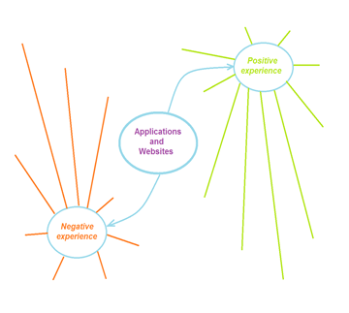
WARM-UP
Complete the mind map with different ideas, and write down the names of the applications /websites you have had positive or negative experiences.

Slide 7
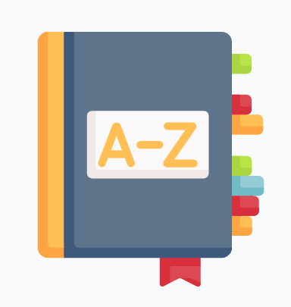
VOCABULARY
seful
findable
desirable
interface
user
end users
tasks
lower-level
avoid
layouts
widgets

Slide 8

Match the synonym of the vocabulary words, put the numbers in the brakes.
Vocabulary word | Synonym
1.useful | Band (together)
2.findable | Costumer
3.desirable | Utile
4.interface | Job/ duty
5.user | Smaller
6.End users | Locatable
7.tasks | Design
8.Lower- level | Object
9.avoid | Consumer
10.layouts | Stay away from
11.widgets | popular

Slide 9

Video: Reading Strategy
https://youtu.be/uU0v8eFO53g

Slide 10
Text Understanding the difference between UI and UX
Understanding the difference between UI and UX
User Interface (UI)
User interface modeling is a development technique used by computer application programmers. Today's user interfaces (UIs) are complex software components, which play an essential role in the usability of an application. The term “user interface modeling” is mostly used in an information technology (IT) context. A user interface model is a representation of how the end users interact with a computer program and how the system responds.
Modeling user interfaces is an independent discipline. For example, modeling techniques can describe interaction objects, tasks, and lower-level dialogs in user interfaces. Using models as part of user interface development can help understand user requirements, avoid premature decisions about specific layouts and widgets, and make the relationships between different parts of an interface’s and their roles explicit.

Slide 11
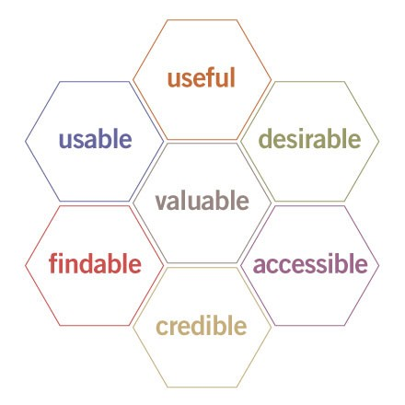

Text Understanding the difference between UI and UX
User Experience (UX)
User experience (UX) is the internal experience that a person has when they interact with every aspect of a company’s products and services. User experience, or UX, appeared as a result of the improvements to UI. ‘User experience’ includes all aspects of the end-user’s interaction with the company, its services, and its products. To understand what makes an experience a good one, a great visual was created to specify what goes into effective UX design.
This ‘usability honeycomb’ is foundation for best practices for UX professionals. UX designers have the responsibility to guarantee that the company creates a product or service that gives a positive UX. UX designers work closely with UI designers.

Slide 12

WRAP-UP
Work with the three question in a Jamboard or Padlet tool.
What is User Interface?
What is User Experience?
What makes UX great?

Slide 13
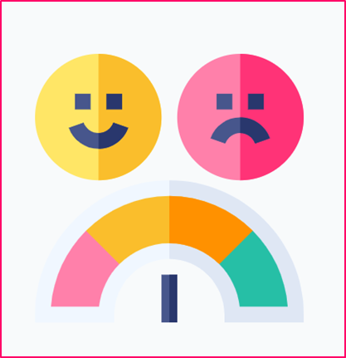
SELF-EVALUATION
Answer the following questions.
1.Entiendo la diferencia entre UI y UX.
Si No Tal vez
2 .Entiendo cómo utilizar un organizador gráfico para hacer un resumen de un texto.
Si No Tal vez
3.Usar un organizador gráfico me ayuda a entender y recordar la información de un texto mejor.
Si No Tal vez

